Slide 1
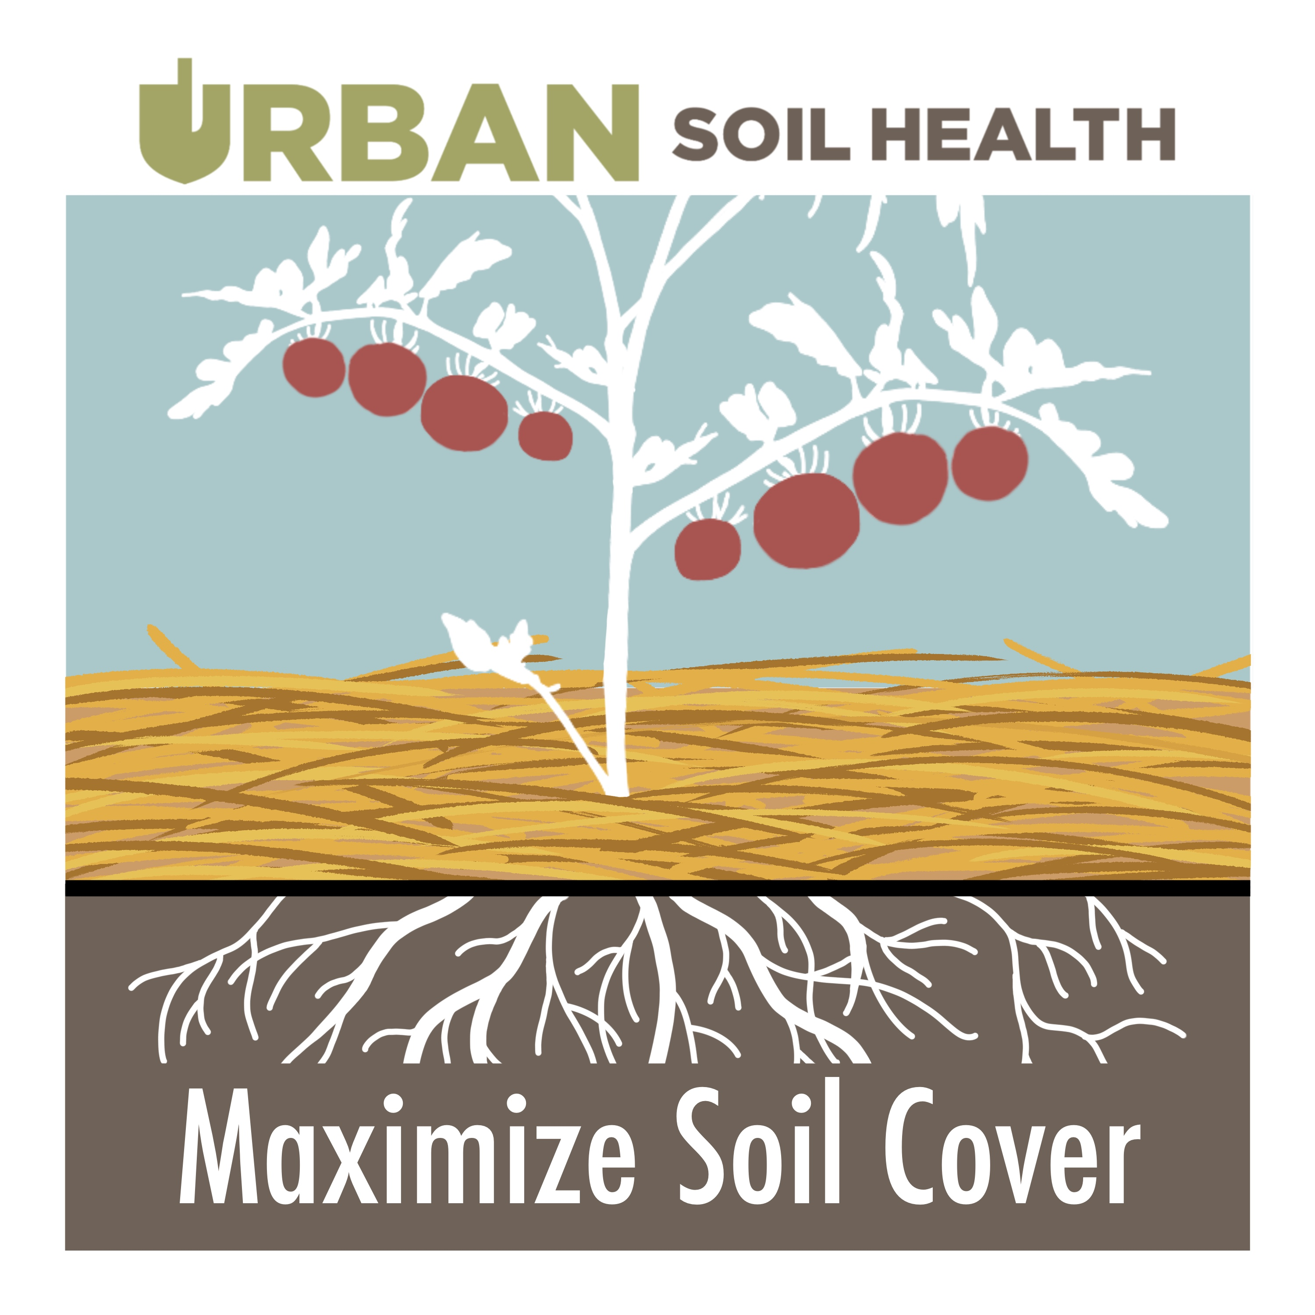
MODULE 6
Soil Health Principle 3:
Maximize Soil Cover

Slide 2
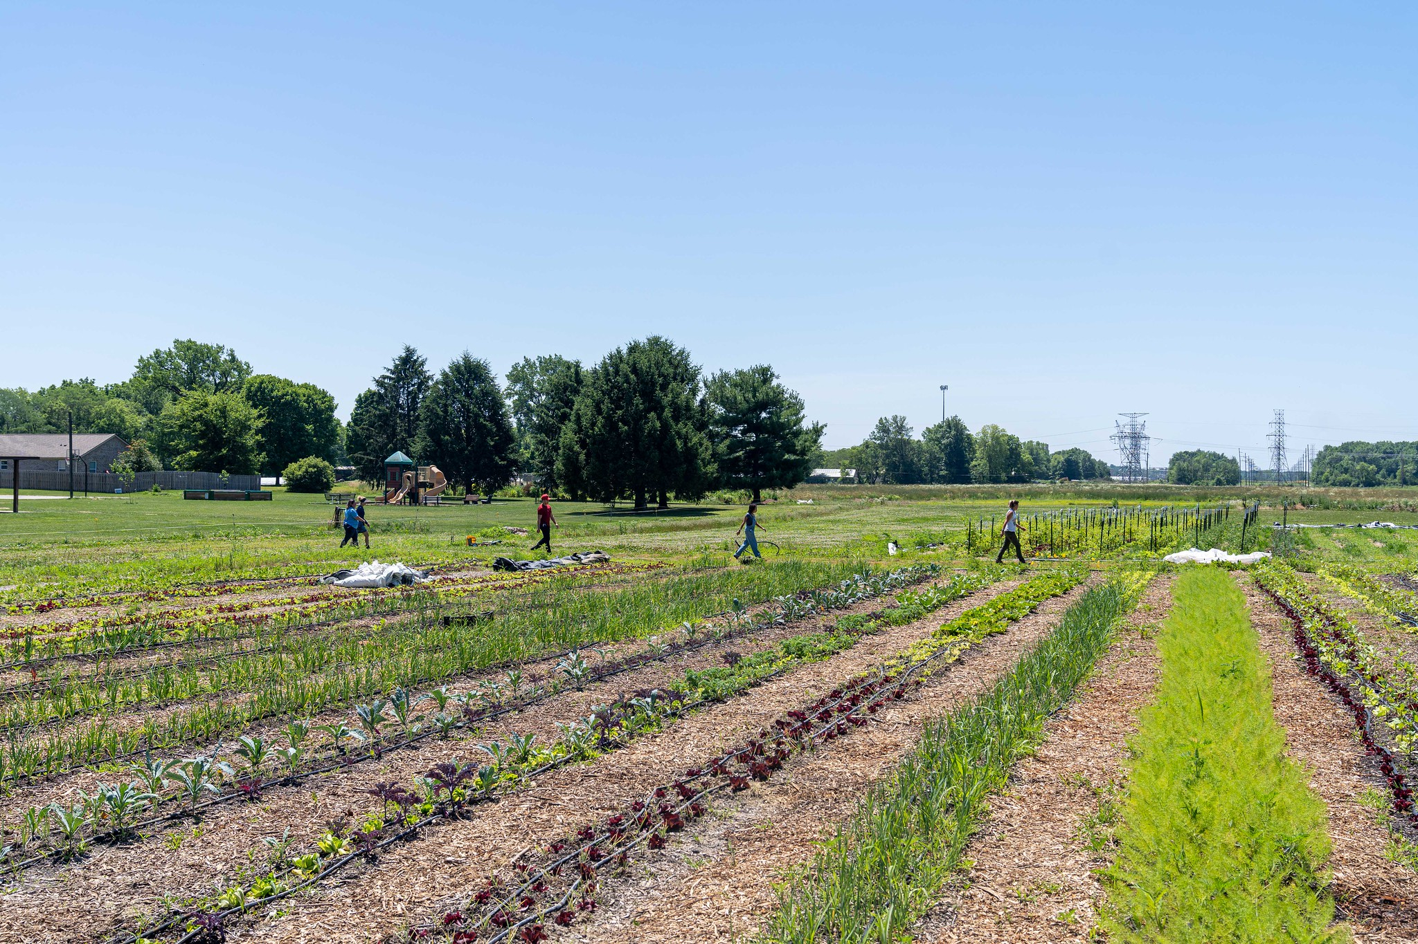
Objectives
Learns about the 3rd principle of soil health (maximize cover) and its importance for urban and small farms.
Identify practices that cover soil, what resource concerns it addresses, and how to plan and apply the practice.

Slide 3
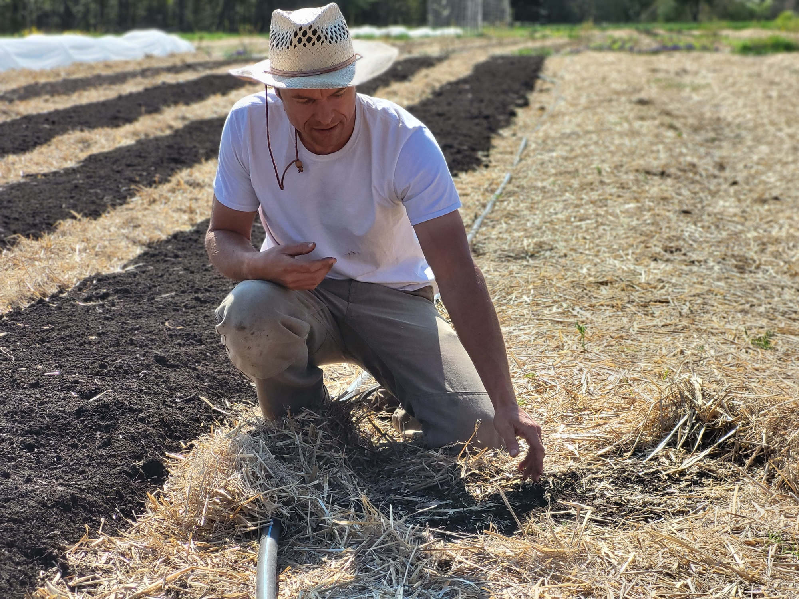
“If the sun can see the soil, then a weed can see the sun.”
Daniel Mays,
owner of Frith Farm (Maine) and author of “The No-Till Organic Vegetable Farm”
Notes:
Mulch has the added benefit for the producer of significantly reducing weed pressure and can reduce soil disturbance either from herbicides and or weeding (including tillage).

Slide 4
Importance of Soil Cover – Crucial for Urban and Small Farms!
In addition to the soil health benefits, soil cover:
Reduces weed pressure.
Improves albedo (light reflection vs absorption) if natural, light-colored mulches are used.
Reduces need for irrigation (which can be costly or contain elements that build up over time like salts).
When properly implemented, can be an effective strategy at reducing exposure to soil which may be contaminated by lead.

Slide 5
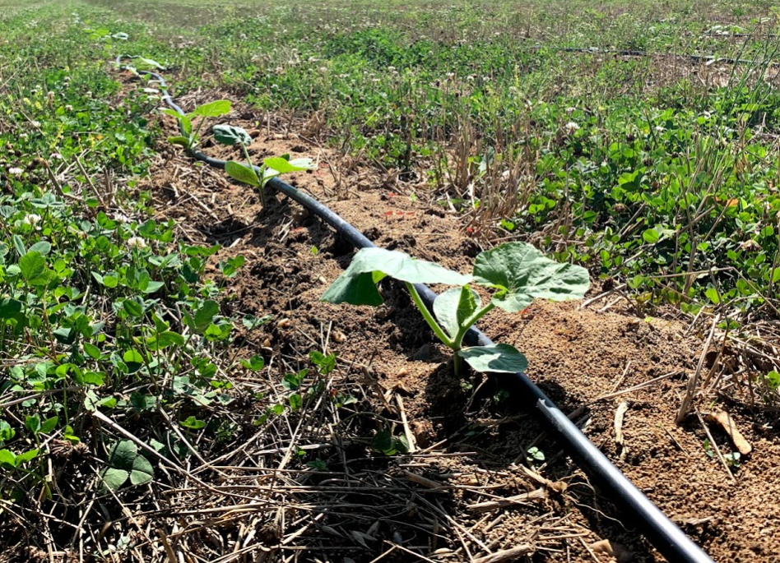
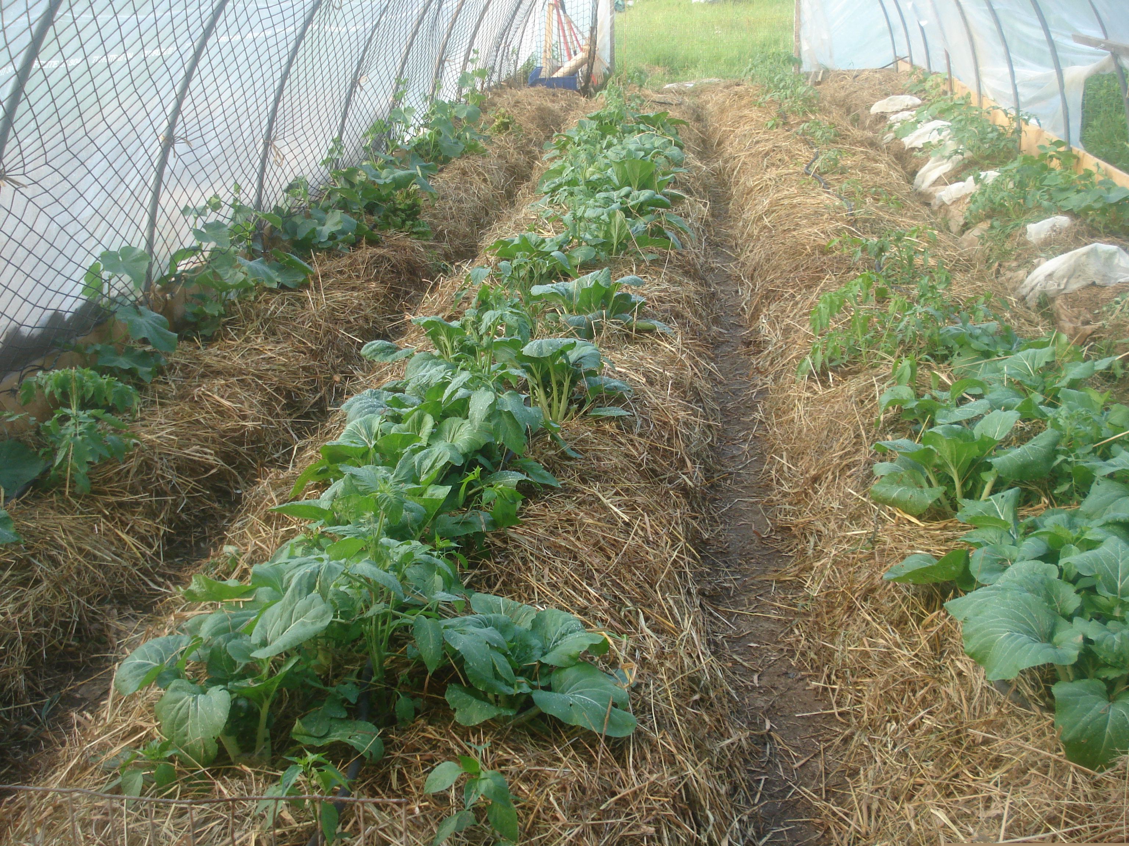
Common Practices Cropland:
340 Cover Crop 484 Mulching
Notes:
Soil cover by cover crops can include both living and dead vegetation. In the photo above left, the producer no-tilled squash plants into a residue of fall planted, winter terminated oats and planted a living cover of clover. The clover shades the soil, add nitrogen, and its roots hold soil in place while adding organic matter. That along with drip irrigation has significantly reduced the amount of water this farmer needs for irrigation. The photo on the right shows mulching being used in a high tunnel. Not only does it suppress weeds, but the mulch significantly reduces the amount of water needed. Urban and small farmers sometimes have to pay for water so this can be a significant cost savings. Also, salt build up in high tunnels can happen the more irrigation water is used.

Slide 6
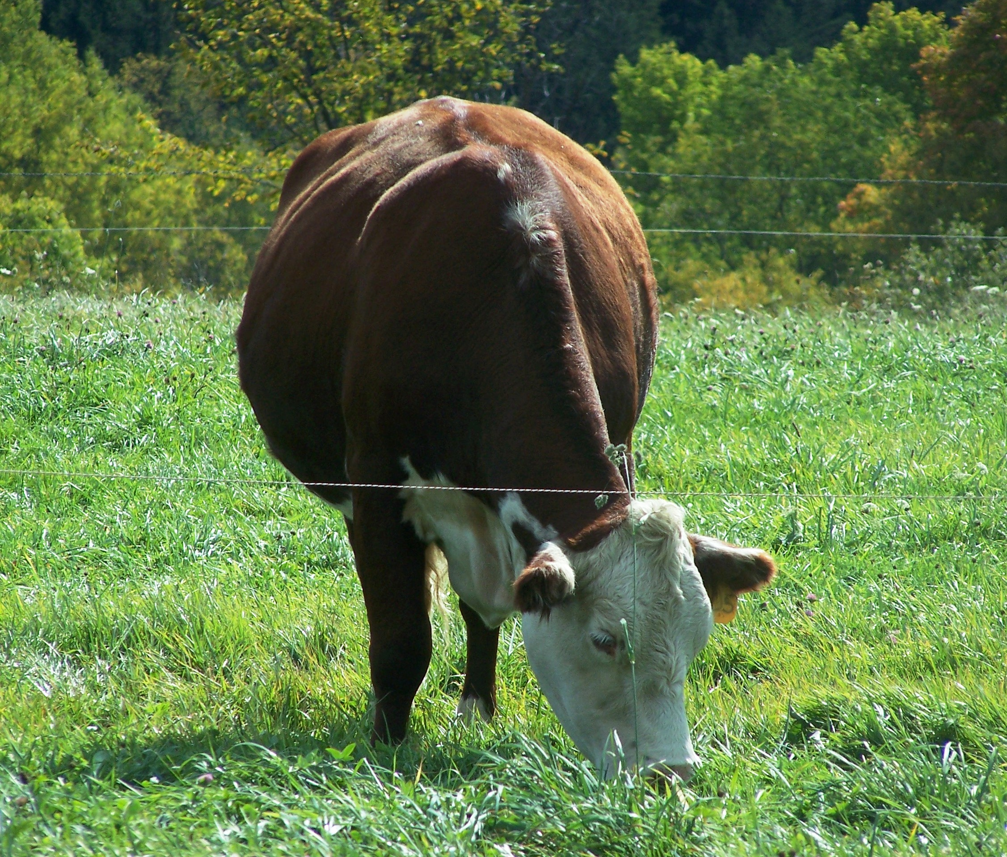
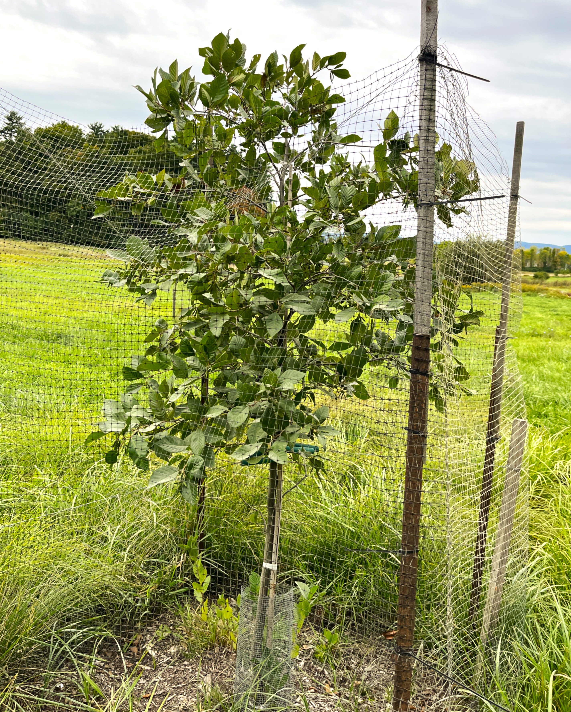
Common Practices Grazing/Rangeland
and Forests
528 Managed Grazing Tree Planting Practices (311, 391, 422, 612)
Notes:
Keeping forage tall greatly reduces the temperatures of the soil and conserves moisture.
Tree planting practices can provide shade which also reduces the temperature of the soil. Lower soil temperatures reduce evapotranspiration. Tree planting practices include:
311 Alley Cropping
391 Riparian Forest Buffer
422 Hedgerow Planting
612 Tree and Shrub Planting
825 Culturally Significant Plantings

Slide 7
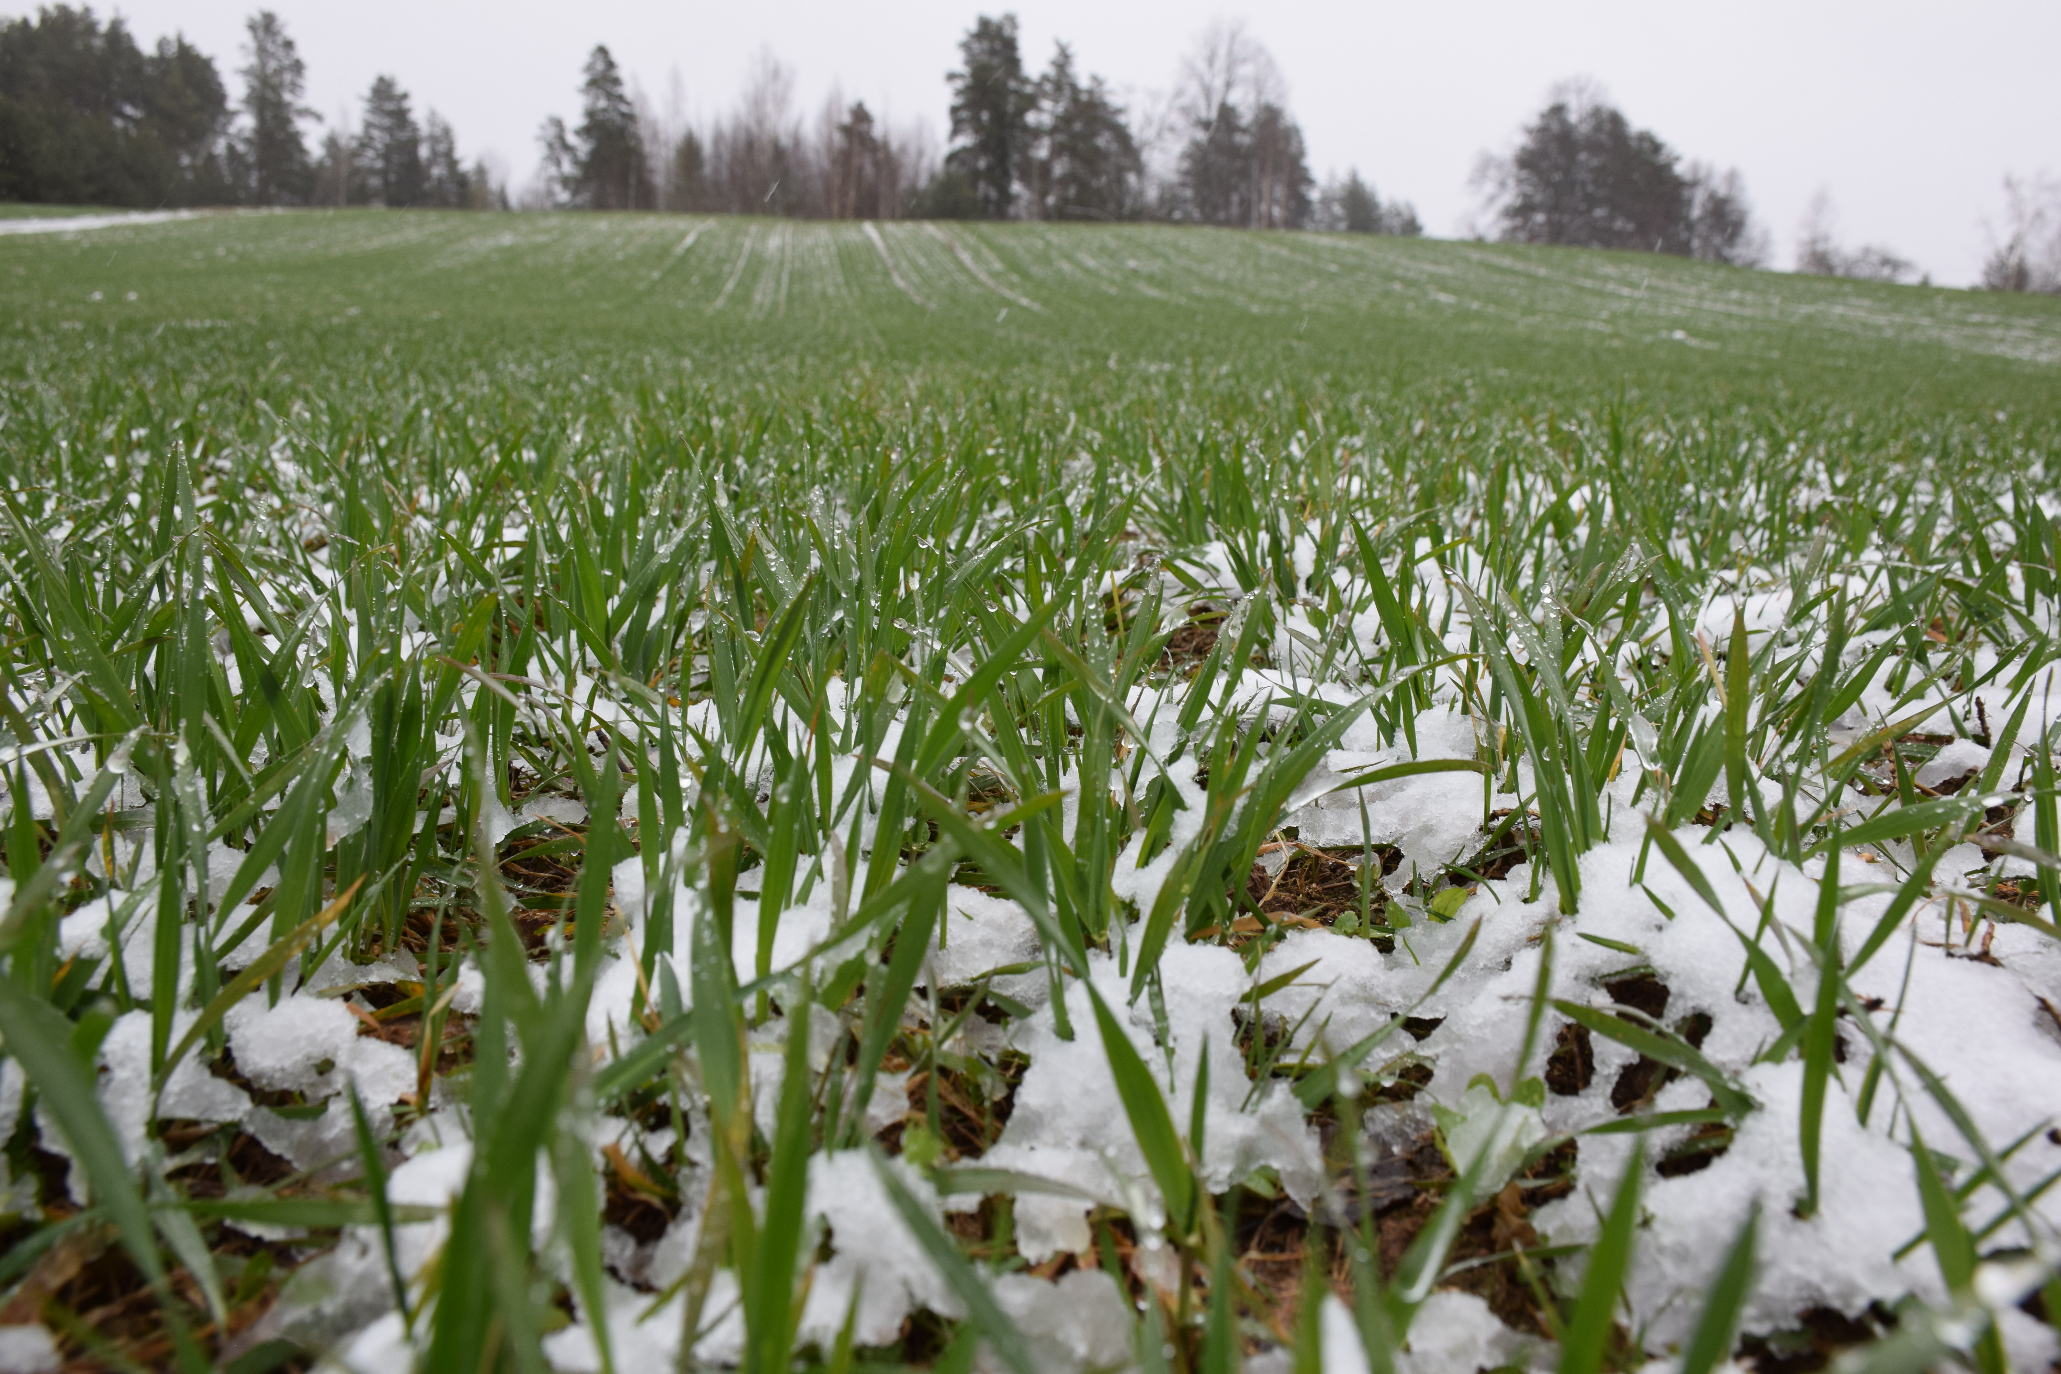
Soil Cover Can Help Mitigate Increased Soil Temperatures and Changing Moisture Regimes
Notes:
Soil cover is the number one way to moderate soil temperatures and changes in soil moisture. This can even happen in winter. In places where ground may have been frozen all winter covered in a protective blanket of snow, some places are experiencing more freeze-thaw making the ground more susceptible to erosion. Also, cover can keep the soil from experiencing extremes in spring.

Slide 8
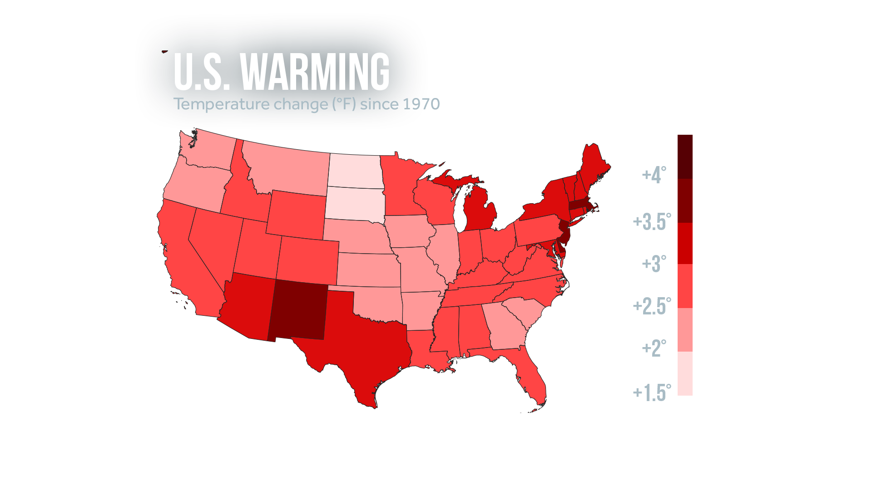
US Change in Temperature (°F)
Since 1970
Notes:
All 50 states have warmed since 1970.
These increases in temperature have been observed in the United States, however not all parts of the US have been warming at the same rate. The Northeast, and West have seen the greatest increases in temperatures while the southeastern parts of the US have seen the least change.
The 49 states analyzed by Climate Central have warmed by 2.7°F on average since 1970.
Alaska was the fastest-warming state by far, due to its high latitude.
Hawaii is also warming. The latest NOAA State Climate Summaries found warming across the Hawaiian islands since 1950. Honolulu has warmed 2.6°F since 1950; since 1975, the city has consistently been above the 1951–1980 average.
From: https://www.climatecentral.org/climate-matters/earth-day-fastest-warming-cities.

Slide 9
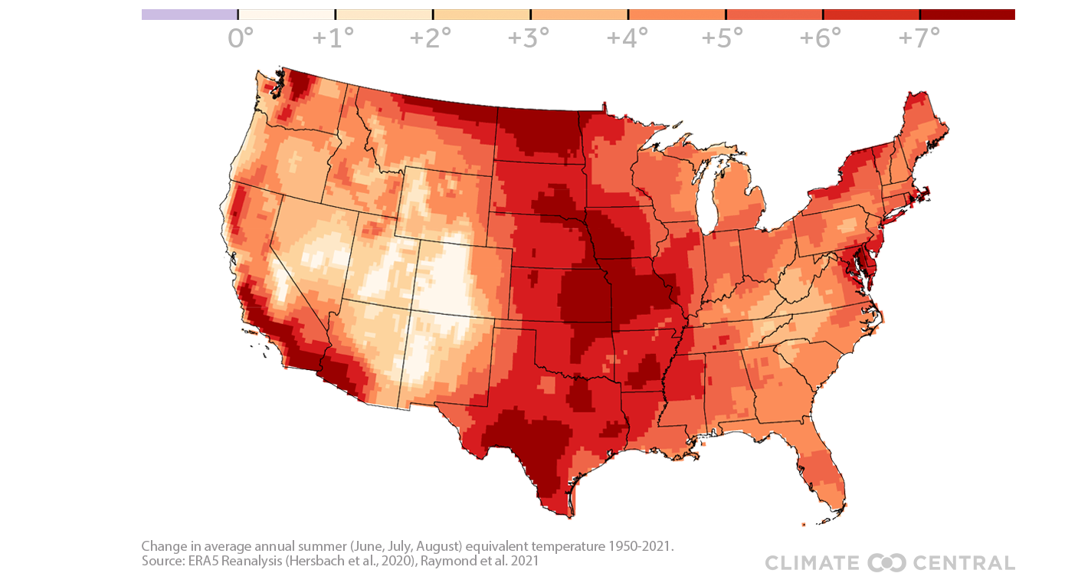
Change in Summer Equivalent Temperatures (Heat Plus Humidity)
Since 1950 (F)
Notes:
Not only has temperatures been increasing rapidly over the last 100 – 150 years, but summer equivalent temperatures have been increasing even greater than average temperatures. Summer equivalent temperatures, or heat plus humidity, means how hot does it feel. During the summer, this increased heat stress can affect heat stress in animals, plants, and humans. An effective way to deal with heat stress is to make sure animals have shade such as from trees or structures. Pastures and hay fields with a diversity of plants and taller vegetation are more resilient and abundant in forage than those that are overgrazed or clipped short.

Slide 10
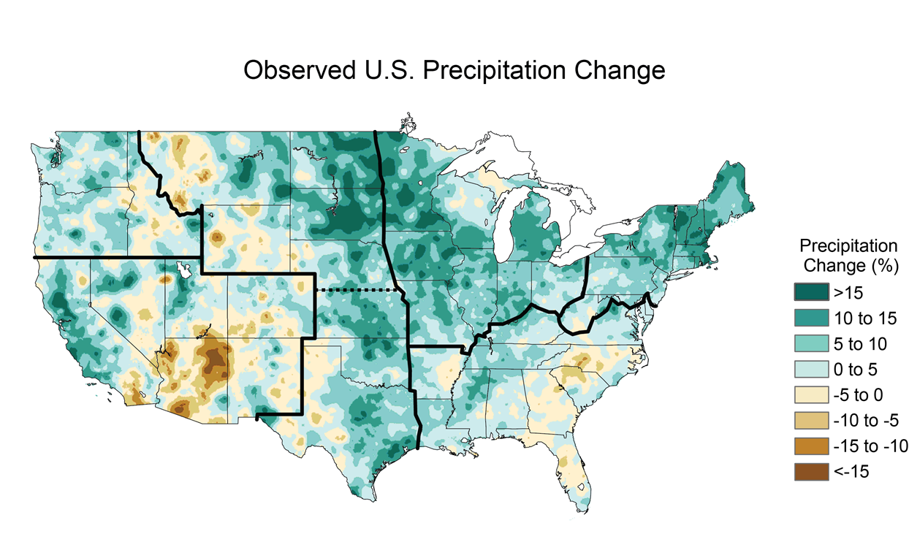
Average US Rainfall Change Since 1895
Source: EPA Climate at a Glance based on NOAA Data
Notes:
Rainfall has changed too, with wet areas becoming wetter and dry areas becoming drier.

Slide 11
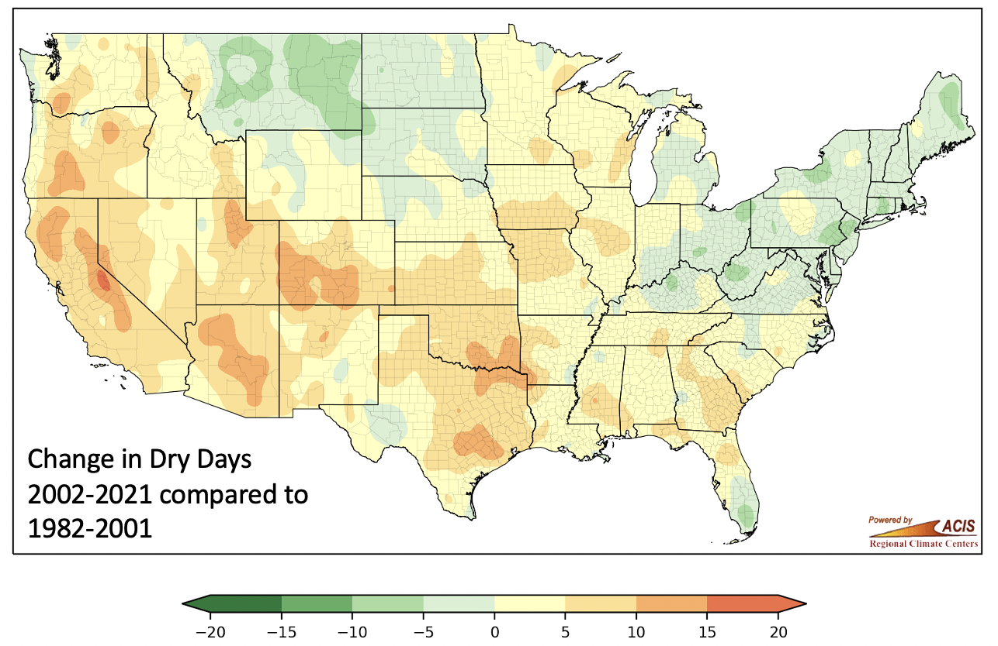
Change in Annual Number of
Days Without Rain
Notes:
While average rainfall may be increasing, the change in annual number of days without rain is also increasing in many parts of the country. Rainfall is coming in larger storms with longer drier periods. So an area may both see higher rainfall and an increase in drought. This graph compares the change in the number of annual dry days over the last 20 years compared to the 20 year time period from 1982 – 2001. Note about the source: This graph was generated by the NOAA, Northeast Regional Climate Center at Cornell University for NRCS using data from NOAA's National Centers for Environmental Informationwww.ncei.noaa.gov

Slide 12
High Soil Temperatures Can:
Speed up biological activity which break down organic matter.
Discourage or kill beneficial soil organisms.
Alter root growth and nutrient uptake which affects yield.
Influence soil evaporation rate – more water is lost the higher the temperature is.
Notes:
The next problem we’ll discuss is increased soil temperatures. Soil temperature affects plant growth in a number of ways. High soil temperatures can discourage or kill beneficial soil organisms. It can reduce root growth and nutrient uptake which affects yield. High temperatures also increase soil evaporation so more water is lost.
Transpiration changes
Stomata close to protect plan

Slide 13
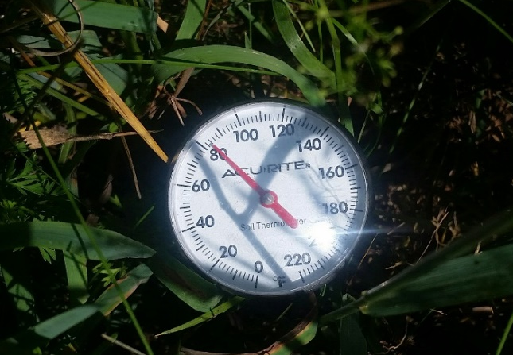
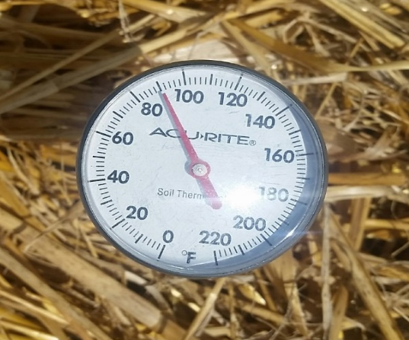
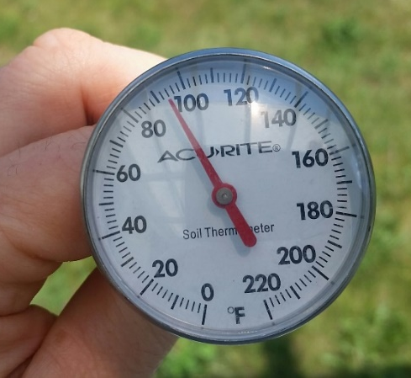
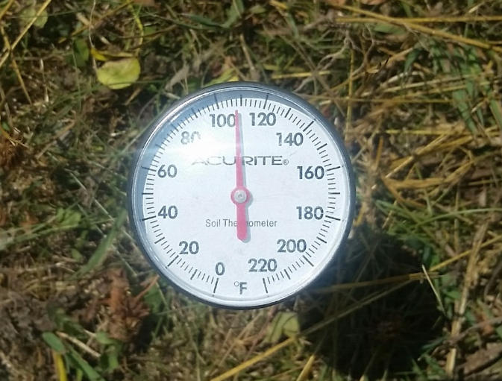
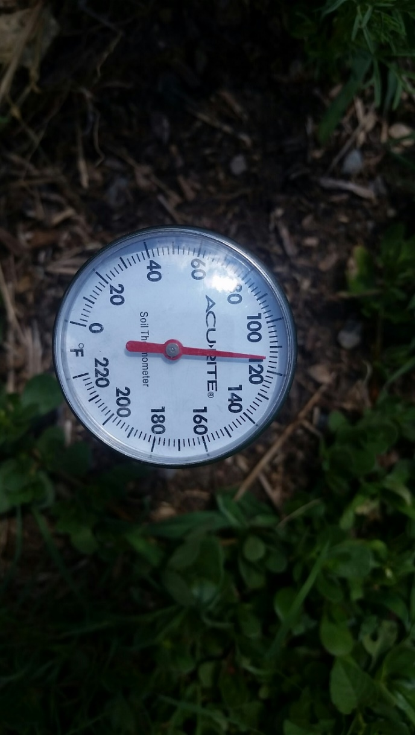
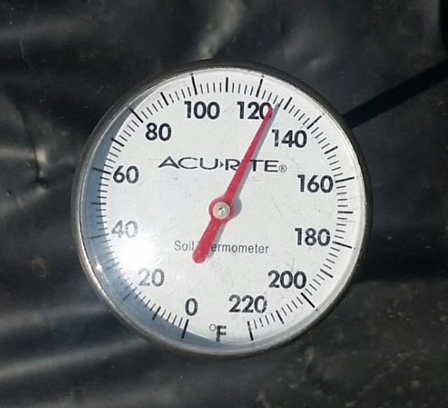
Effects of Cover on Soil Temperature
At 1” depth – same day Chatham, NY Farm – 45 degree difference
Ambient Temperature: 93° F Tall Pasture (8-10”): 83° F Mulched Veggie Beds: 90° F
Overgrazed Pasture (<1”): 108° F Bare Soil: 115° F Black Plastic: 128° F
Notes:
Cover can greatly influence soil temperature. On this warm, sunny, dry day early in the growing season, there was a 45° F difference in soil temperature at 1” depth due to different soil covers.

Slide 14
Temperature Effect on Soil
Biological Communities
Micro-organisms:
Ideal temperature range 50-96 F (Davidson and Janssens 2006)
Soil organisms begin to die above 130 F.
When soil temperatures increase, biological activity increases and organic matter decreases.
Macro-organisms:
Ideal temperature range 50-75.2 F (Bristow 1998)
Notes:
Temperature has an effect on what lives in the soil. For micro-organisms such as nitrogen fixing bacteria and mycorrhizal fungi, ideal soil temperature ranges from 50-96° F. For macro-organisms such as worms or arthropods, the ideal temperature is lower; around 50-75.2° F. Also, the warmer the soil the more biological activity and the more soil organic matter is reduced to carbon dioxide. Warmer soils have a harder time accumulating organic matter.

Slide 15

Soil Temperature and Plant Growth
∼ 90° F and above: Plant and root growth stops; conditions become unfavorable to soil organisms.
80 ° F: Many plants reach peak growth of roots and plants and peak nutrient uptake.
65° – 86 ° F: Ideal range for nitrification, plant growth and planting
Source: James A. Tindall, H.A. Mills & D.E. Radcliffe (1990) The effect of root zone temperature on nutrient uptake of tomato, Journal of Plant Nutrition, 13:8, 939-956
Notes:
In most plants, the ideal soil temperature range for growth and nitrification is 65 to 86°. As soil temperatures get hotter, plant growth slows and eventually stops.
Nitrification means that the organic N forms are being converted to inorganic plant available forms= it’s a good thing

Slide 16
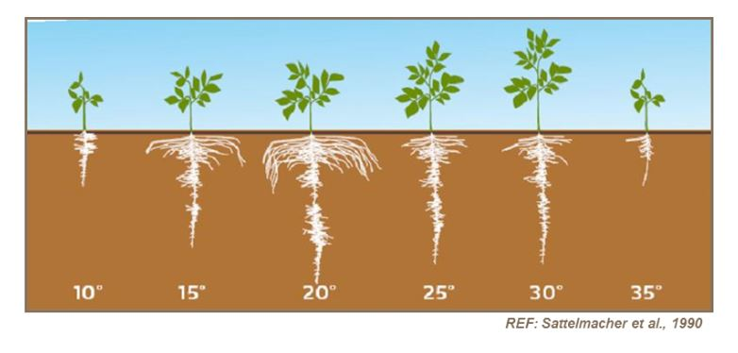
Soil Temperature Affects Root Growth
In most plants, as soil temperature increases above 86° F, root growth starts to shrink and nutrient uptake diminishes.
50° F 59° F 68° F 77° F 86 ° F 95 ° F
Source: B. SATTELMACHER, H. MARSCHNER, R. KÜHNE, Effects of the Temperature of the Rooting Zone on the Growth and Development of Roots of Potato (Solanum tuberosum), Annals of Botany, Volume 65, Issue 1, January 1990, Pages 27–36,
Notes:
This illustration shows root shrinkage of potatoes based on soil temperature. In cool-season grasses, growth stops above 90 degrees F. In corn, it is about 95 degrees F.

Slide 17
Soil Temperature and Moisture
Moisture loss rates from the soil increase on average about 1% per degree in the Northeast. Other factors affecting evaporation include solar radiation, wind and humidity.
98° F soil temperature = 30% higher evaporation rate than at 68°.
88° F soil temperature = 20% higher evaporation rate than at 68°.
68° F soil temperature: most of water in soil is available for plant growth
Notes:
Soil temperature also affects evaporation. The hotter the soils, the more water is lost. Evaporation depends on soil temperature, sun, wind and humidity but on average in the Northeast, evaporation increases 1% with each degree increase in soil temperature. At 68° F, almost all the water in the soil is available for plant growth. When the soil temperature increases to 98° F, the evaporation rate is 30% higher. Water evaporates from soil until a dry layer is formed and then evaporation decreases.

Slide 18
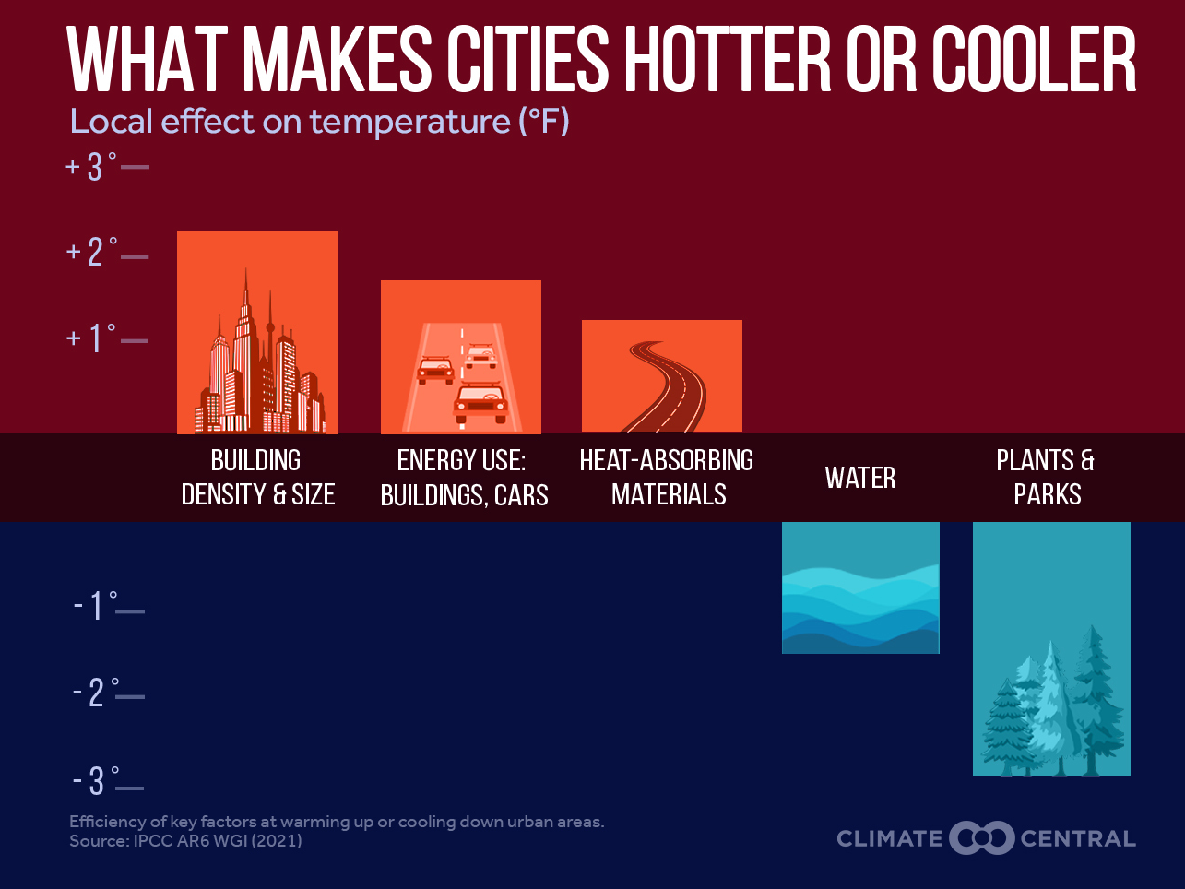
Heat Islands and Albedo
Most urban/developed areas absorb more heat.
Albedo refers to how much light gets reflected rather than absorbed. Low albedo = lots of dark surfaces = hotter temps.
Notes:
Temperatures are more extreme in urban areas.
Data from Climate Central: https://www.climatecentral.org/climate-matters/urban-heat-islands-2024
Across 65 cities, the total population living in census block groups with an Urban Heat Index (UHI) index of 8°F or higher is nearly 34 million. In some cities, it is 9 degrees hotter than the surrounding countryside.
The urban heat burden is unequally shared, and linked to a history of racially biased housing policy. Analysis from Columbia University shows that historically redlined areas currently experience hotter summers than non-redlined areas in 150 (84%) of 179 major U.S. cities.
Planting street trees and installing cool roofs and pavements are among the ways to reduce local heat islands.
Image can be found at: https://www.climatecentral.org/graphic/urban-heat-islands-2024?graphicSet=What+Makes+Cities+Hotter

Slide 19
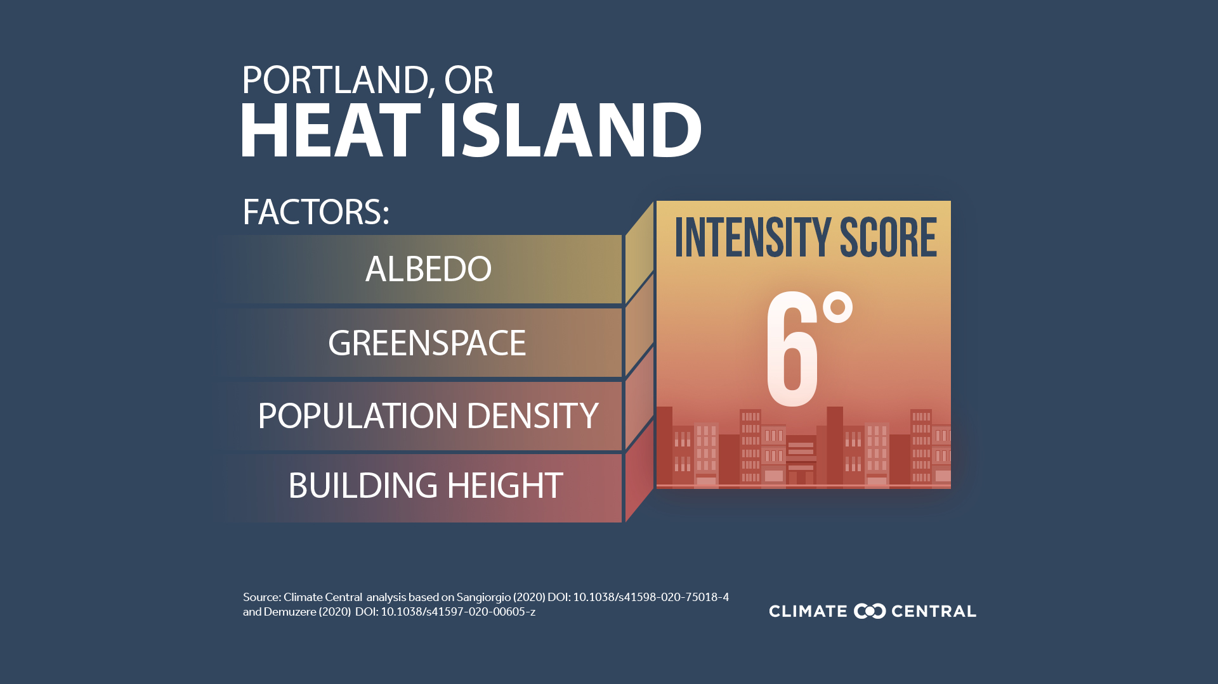
Heat island diagram
Notes:
Replace this graphic with a graphic for the nearest city where the course is being held. Download the intensity score graphic from Climate Central at: https://www.climatecentral.org/graphic/urban-heat-islands?graphicSet=Local+UHI+Score

Slide 20
Tools/Methods (from NRCS Indiana)
Notes:
This is an excellent summary of the pros and cons common mulches used for urban and small farms. Note that leaves coming from urban areas have the potential to be contaminated by lead.

Slide 21
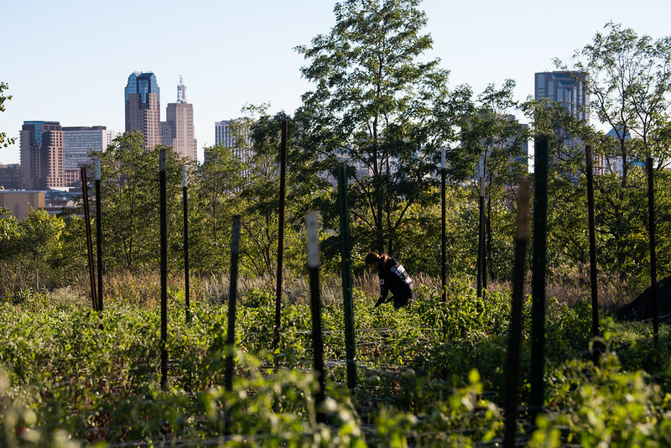
Urban garden with building background
Notes:
Note to Instructors: You can add or replace local pictures of examples of soil cover.
Trees can help lower temperatures in urban and rural areas. They can also be excellent food sources for pollinators and other beneficial insects, a source of mulch (leaves), and/or a food source (fruit trees).

Slide 22
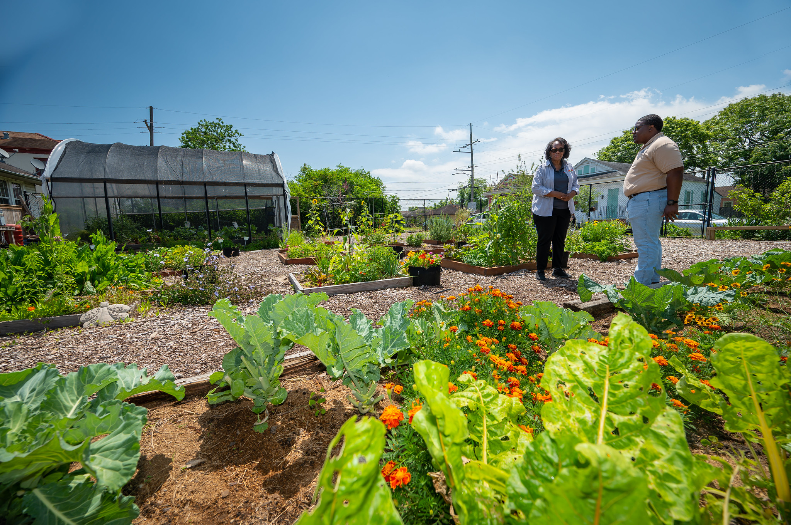
Urban garden photo
Notes:
Nice example of mulch material in bed and wood chips on trails and walkways. Mulch materials outside of growing beds are not fundable under 484 Mulching standard.

Slide 23
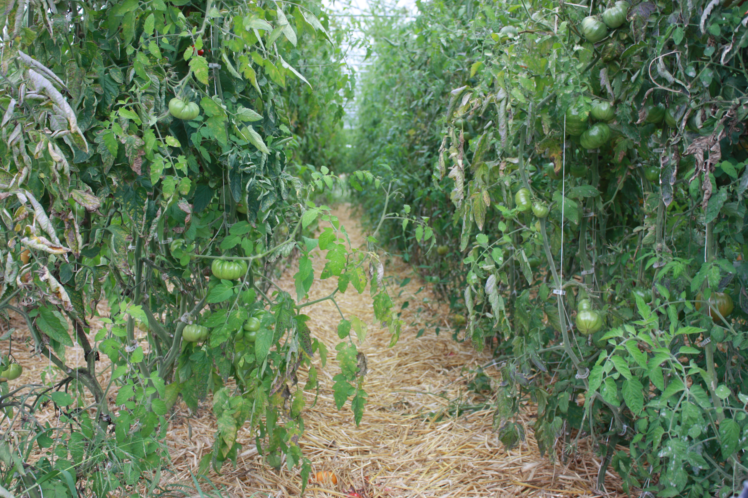
Mulched tomatoes photo
Notes:
Picture of mulch being used in a high tunnel. Reducing irrigation in high tunnels can save the producer money (if they are paying for water). If less water is applied, it reduces the amount of salt buildup that can occur in the soil.

Slide 24
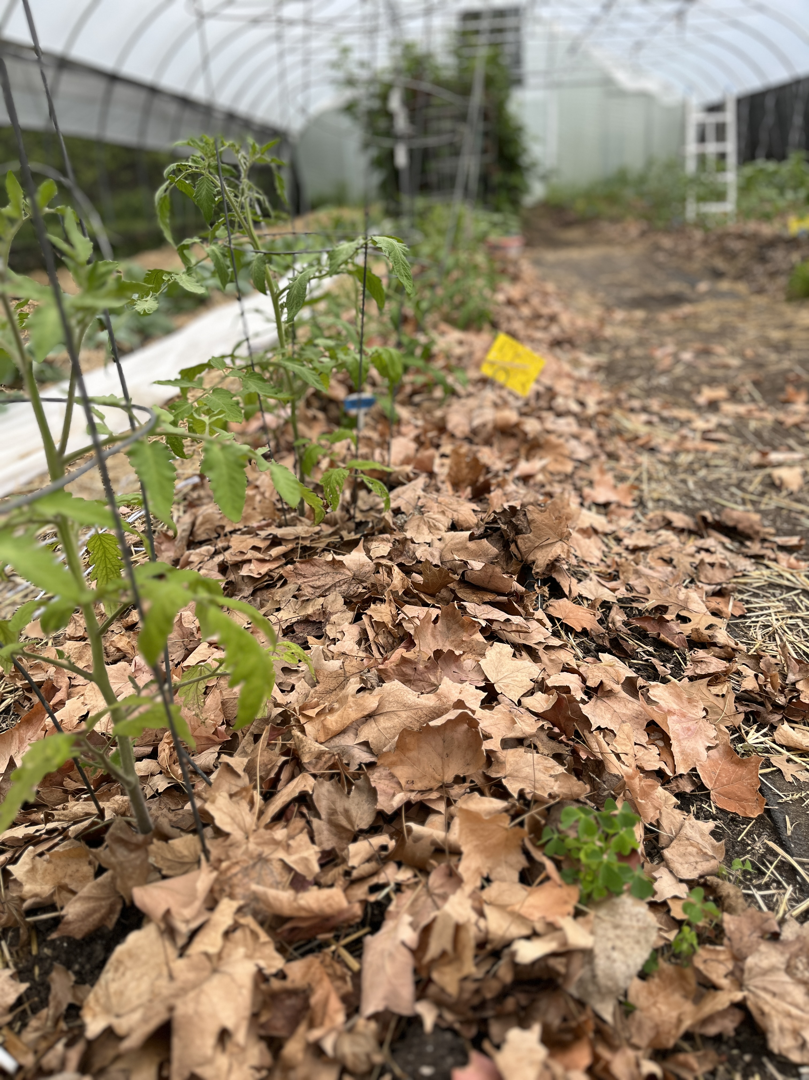
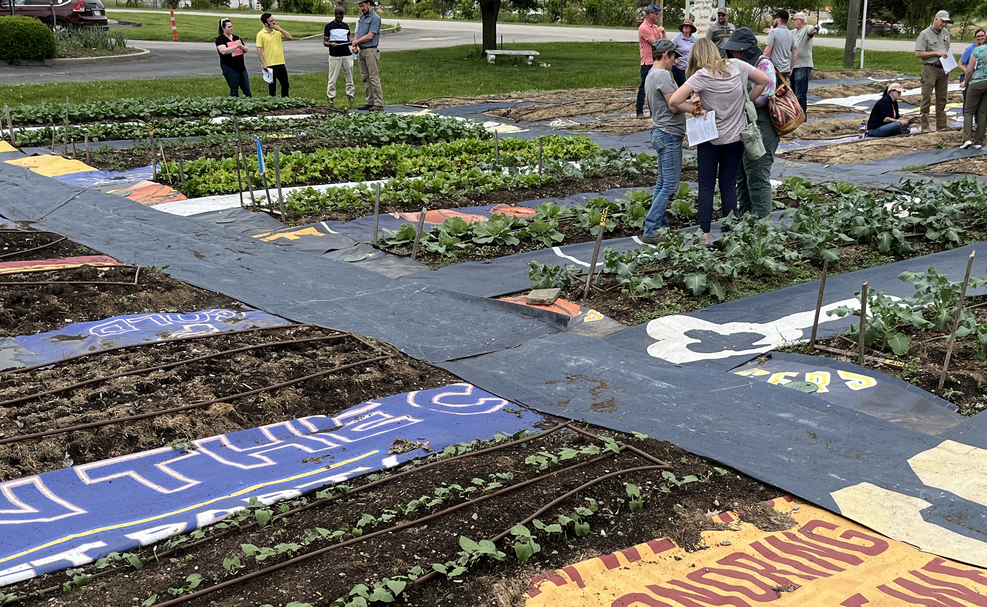
Community garden photo
Notes:
While leaves and compost made from leaves can be an excellent, low cost source of organic matter, use caution if the leaves are sourced from urban areas as they can contain lead.

Slide 25
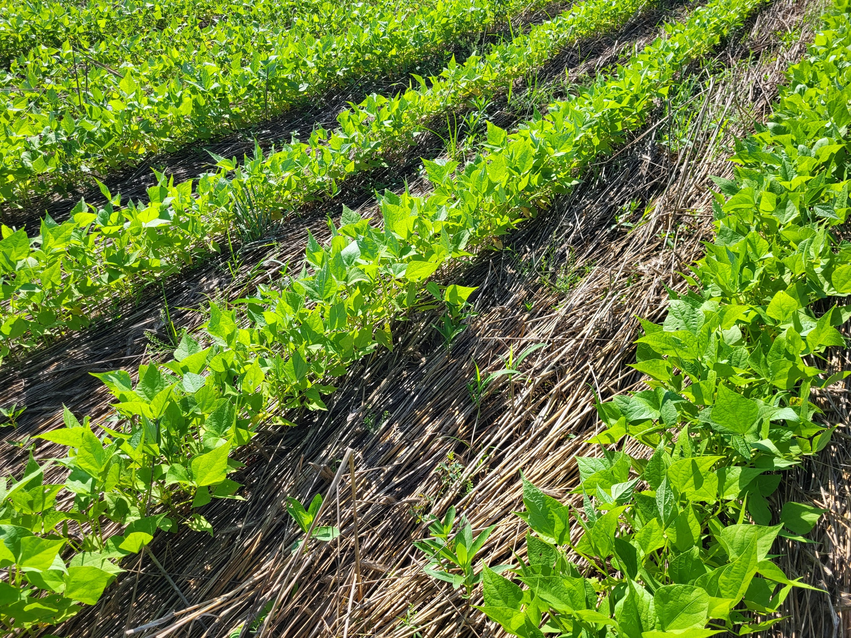
Mulched soybeans photo
Notes:
Winter rye terminated in the spring by roller crimping and soy beans no-till drilled into it.

Slide 26
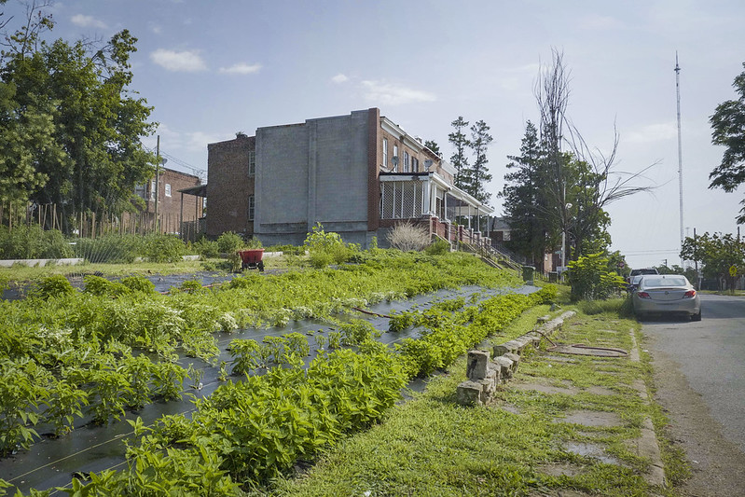
Building with a garden photo
Notes:
Summertime use of black plastic can not only over heat the soil affecting plant growth and soil biology, but it can contribute to dangerously high temperatures for humans.

Slide 27
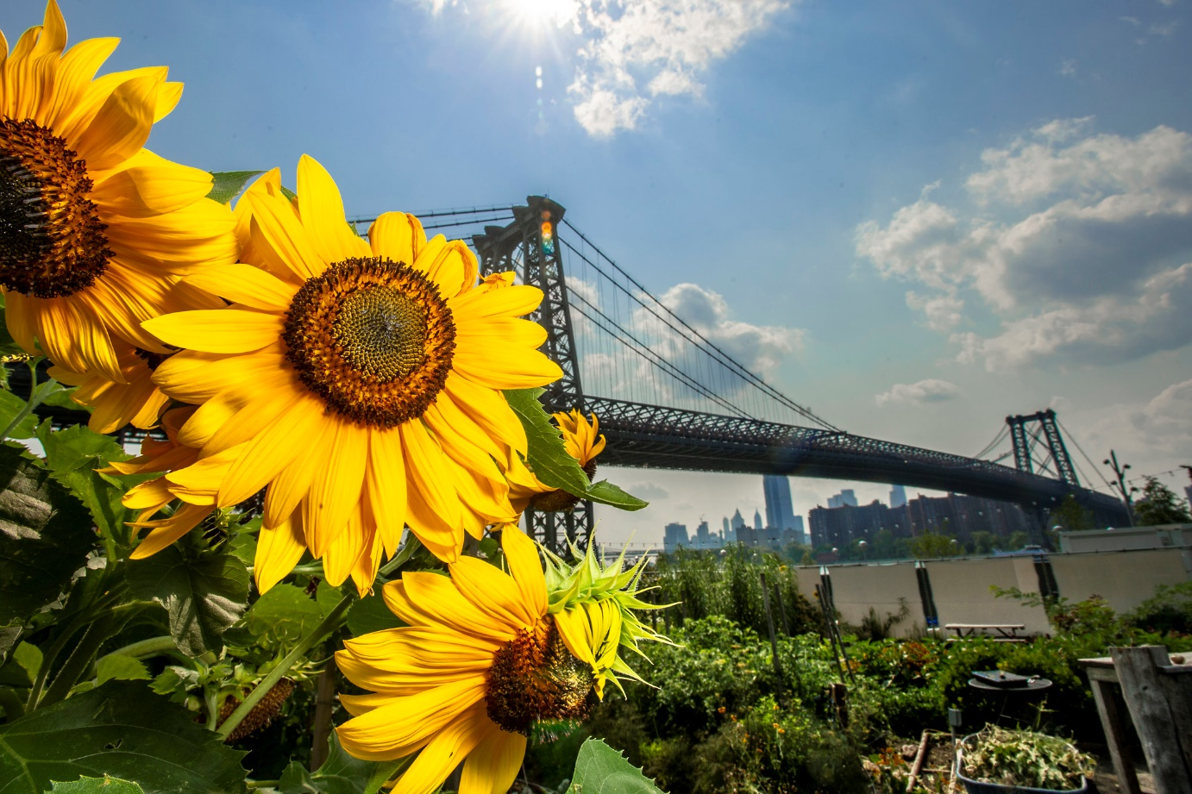

Pair and Share:
How can your local climate can affect how you plan?
Download the
Climate Quick
Reference
Guide for Your
State:
Notes:
Have participants get in groups of two (preferably pairs will be from the same state) and download the Climate Quick Reference Guide for their state.

Slide 28
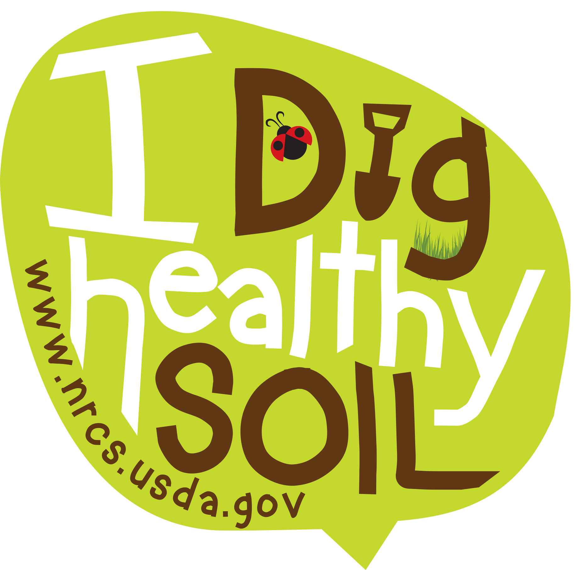
Questions and Review
Soil cover (not black plastic) is particularly important on urban farms as it reduces soil temperature and can help reduce airborne soil.
High soil temperatures can increase evapotranspiration and increase water needs for plants. It can also harm soil organisms and slow or stop plant growth.
Questions?

Slide 29

This information is provided as a public service and constitutes no endorsement by the United States Department of Agriculture or the Natural Resources Conservation Service of any service, supply, or equipment listed.
While an effort has been made to provide a complete and accurate listing of services, supplies, and equipment, omissions or other errors may occur and, therefore, other available sources of information should be consulted
The USDA is an equal opportunity provider and employer.
Meeh, NRCS

